Slide 1
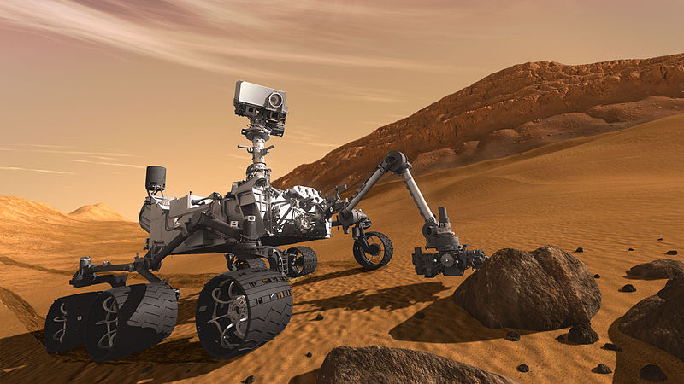
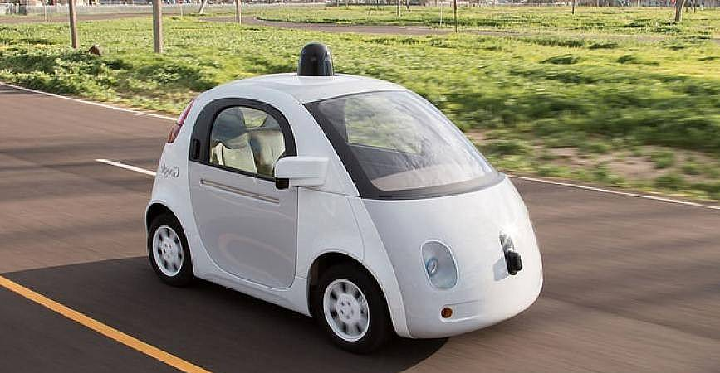
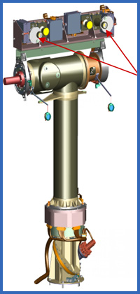
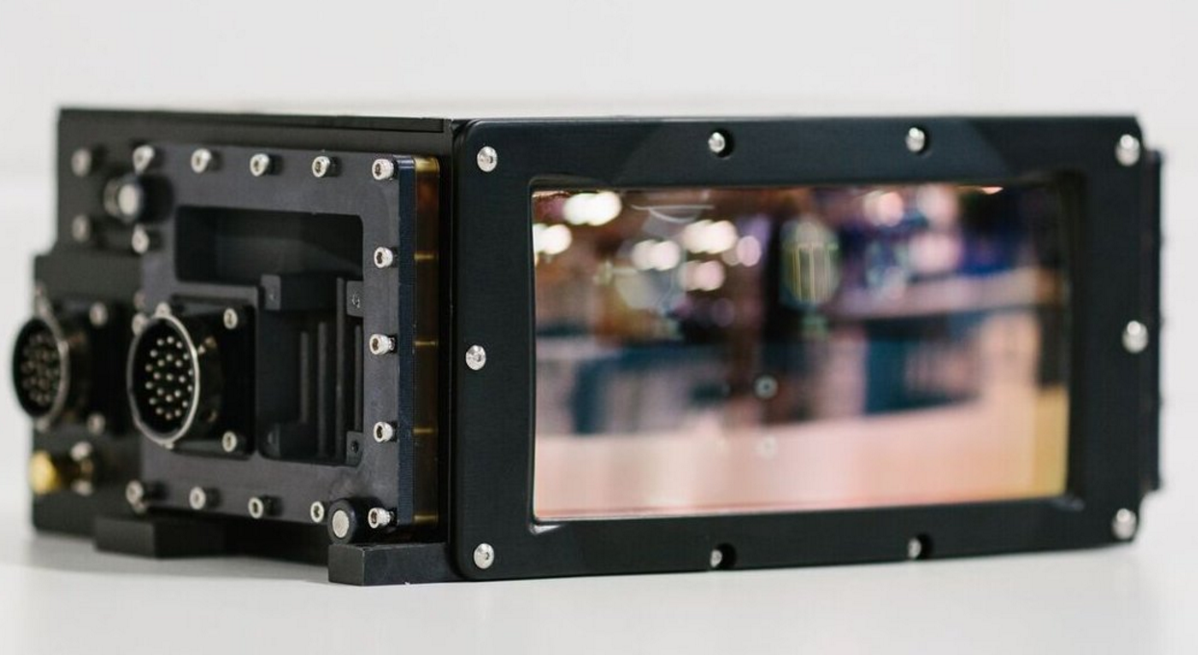
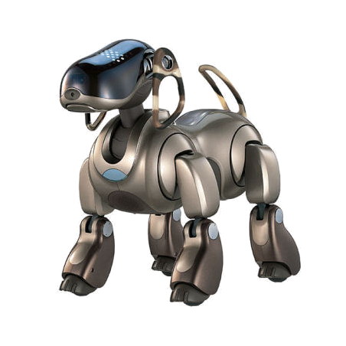
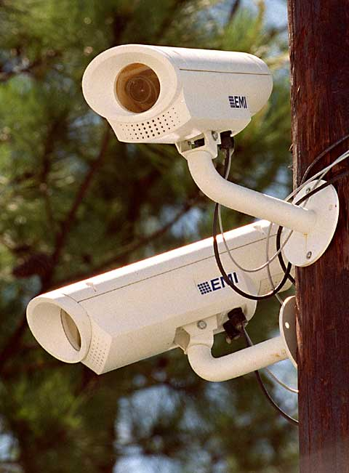
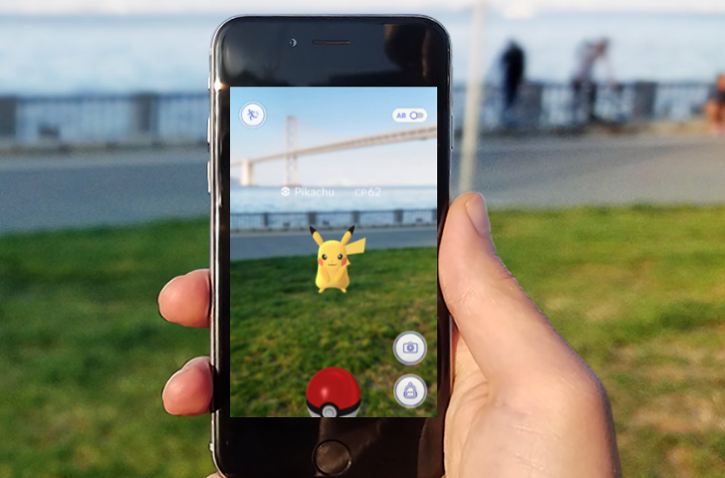
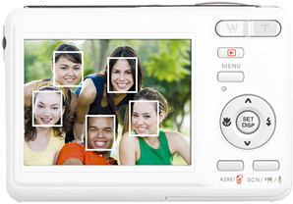
CSC589: Intro to Computer Vision
Instructor: Bei Xiao, American University, Spring, 2019

Slide 2
Today’s class
Introduction
What is computer vision?
Why vision is hard?
Applications of computer vision
What we will learn in this course

Slide 3
First week’s task
Finish the to-do list on First Steps
Numpy tutorials
Set up Python and OpenCV
Finish the course survey (will send out today)

Slide 4
Instructor
Bei Xiao (bxiao@american.edu)
Research interests:
Human vision
Computer vision and graphics
Machine learning for estimation materials of objects
Tactile visual integration
VR

Slide 5
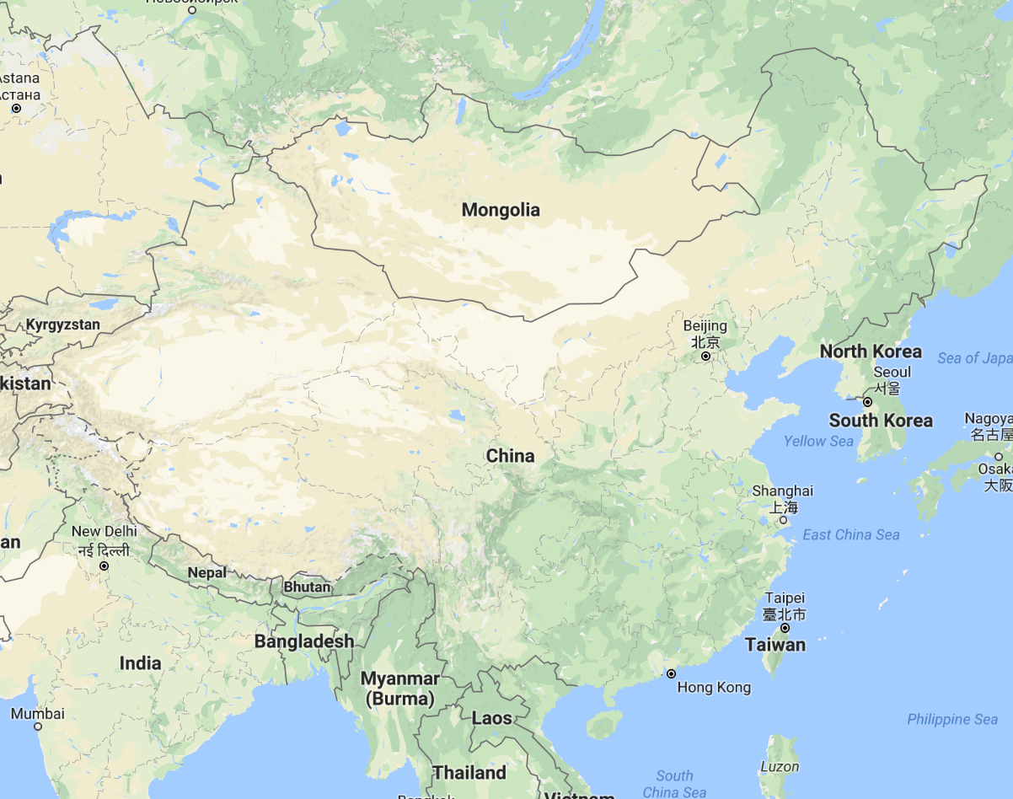
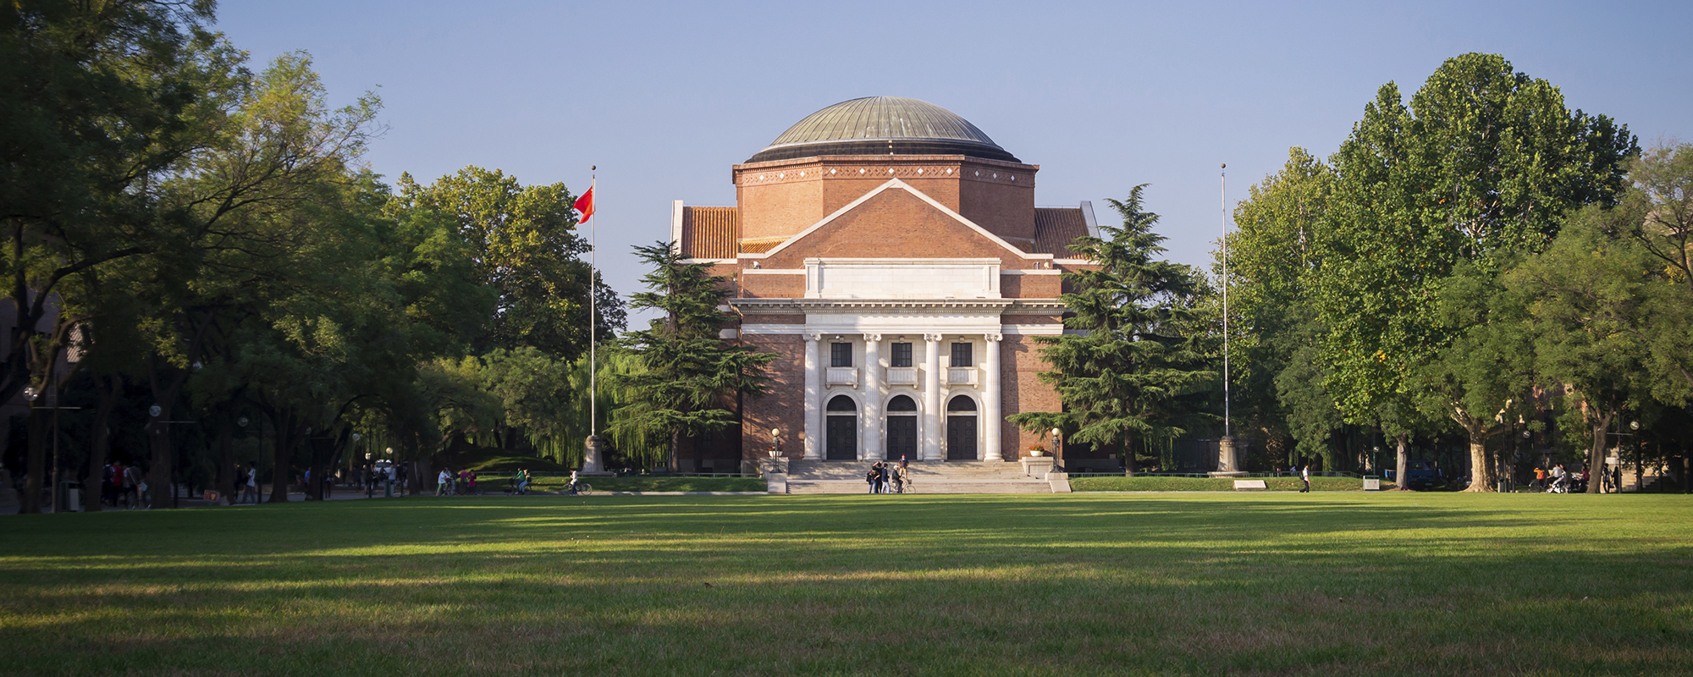
A bit about me
College:
Tsinghua University
Beijing, China
Degree: Chemistry

Slide 6
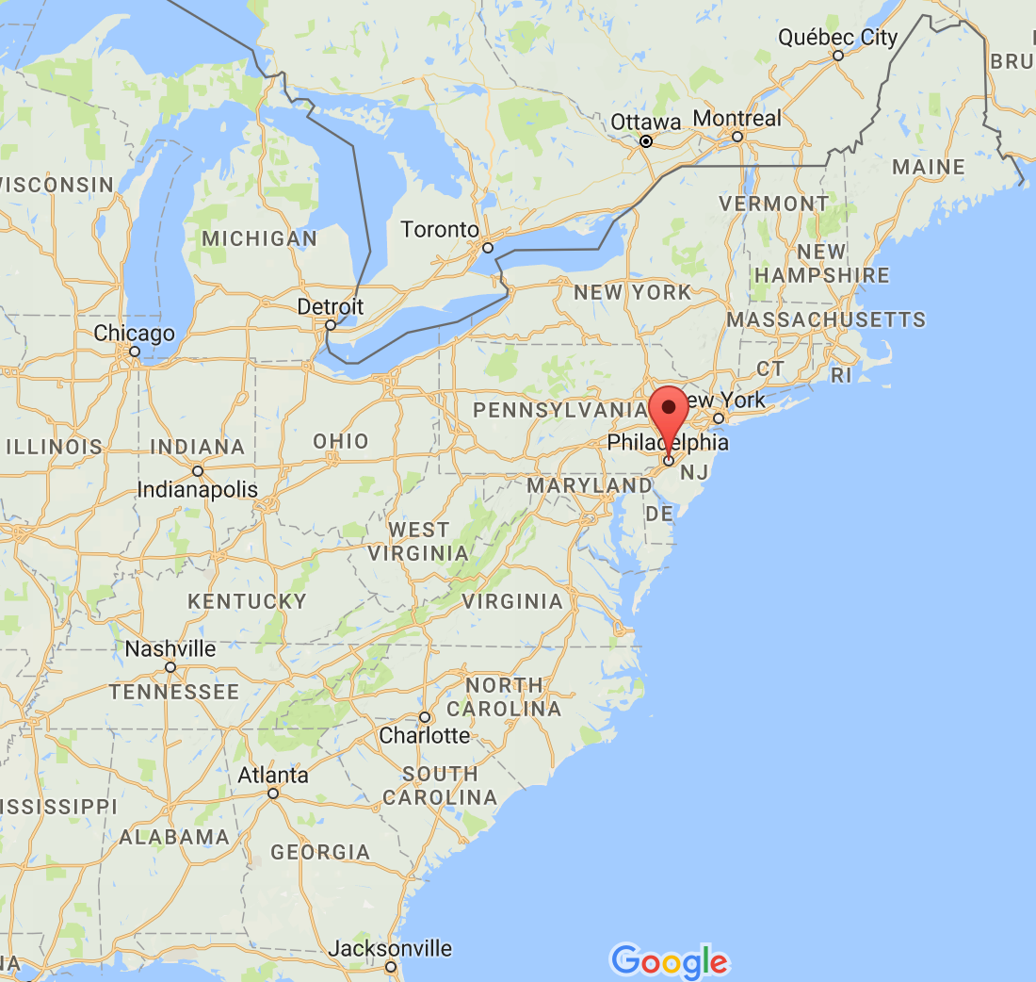
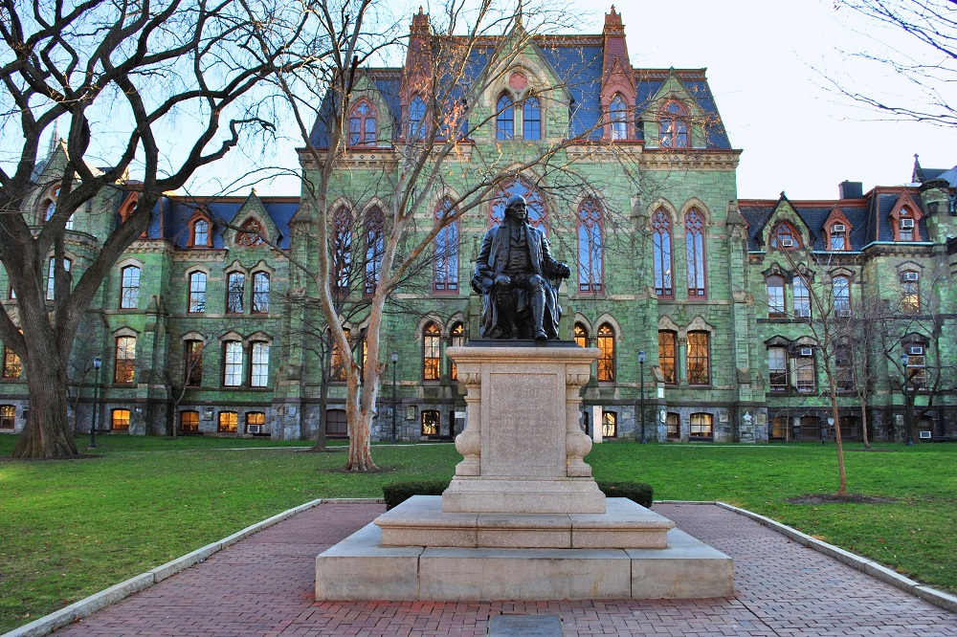
A bit about me
Graduate School:
University of Pennsylvania
Philadelphia, PA
Degree: Computational neuroscience

Slide 7
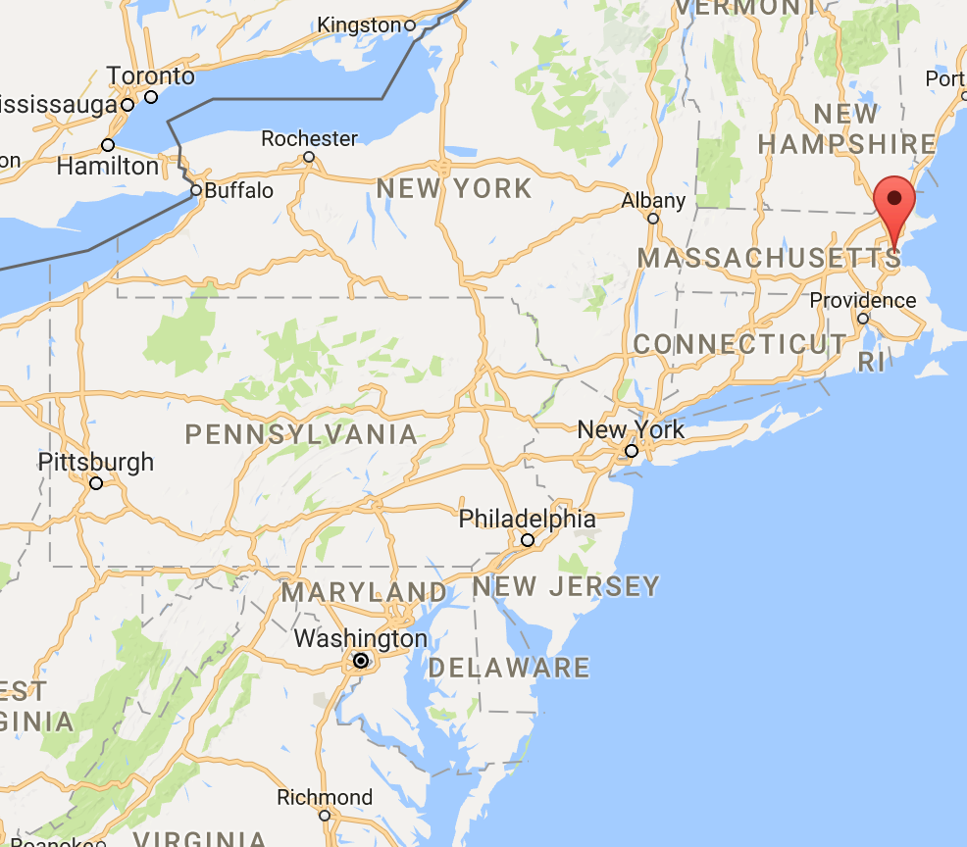
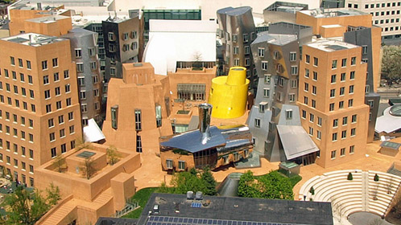
A bit about me
Postdoctoral Fellowship:
MIT
Cambridge, MA
Computer Vision and Human Perception

Slide 8
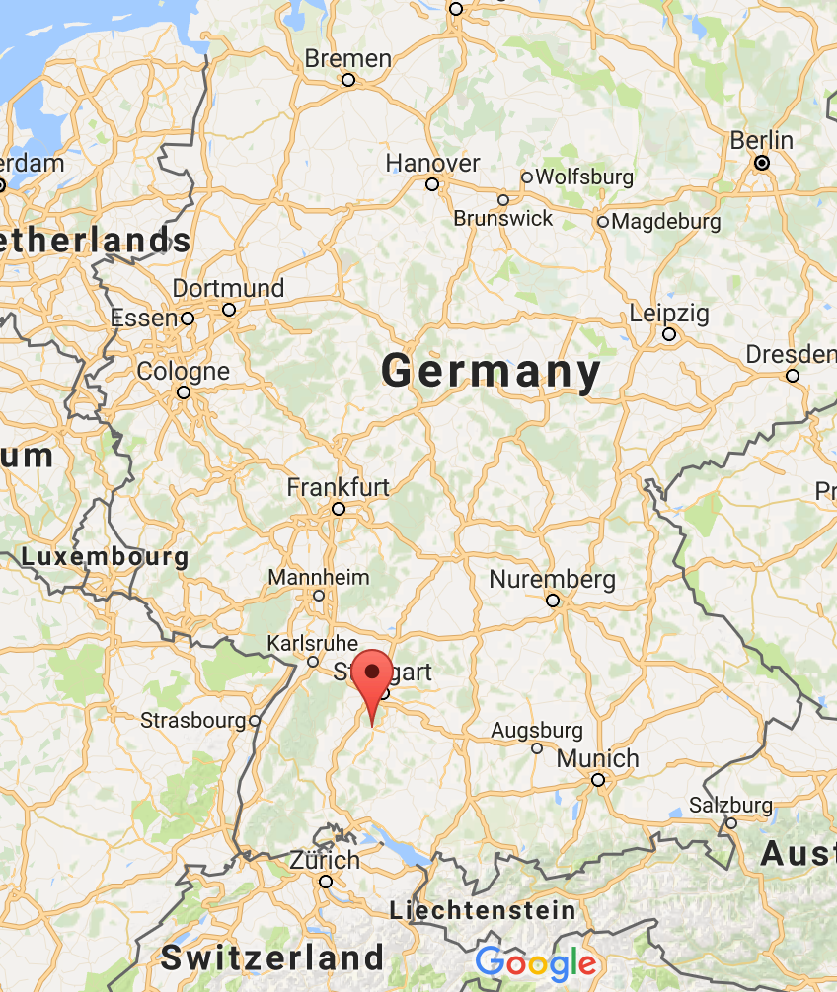
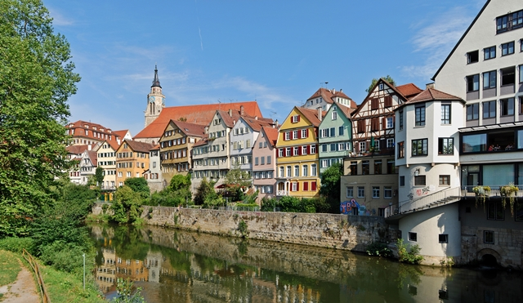
A bit about me
Research Sabbatical
University of Tuebingen
Tubeingen, Germany
Human Perception &
Computer vision

Slide 9
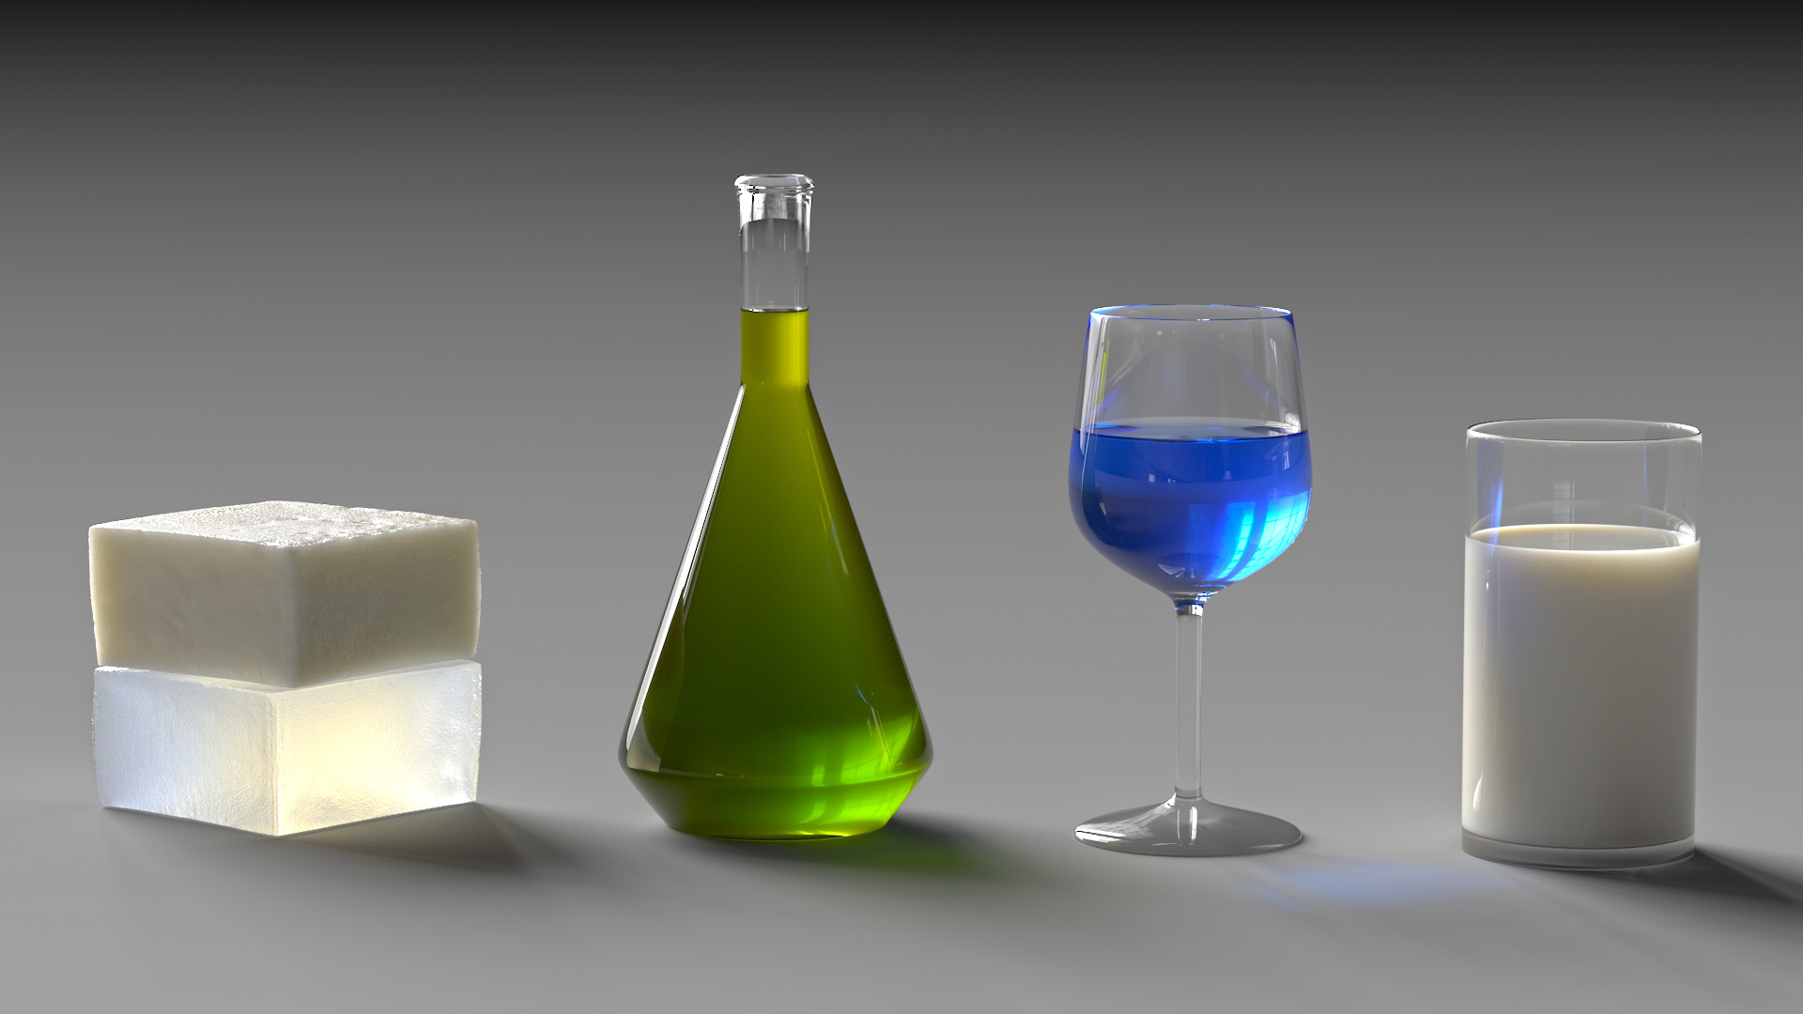
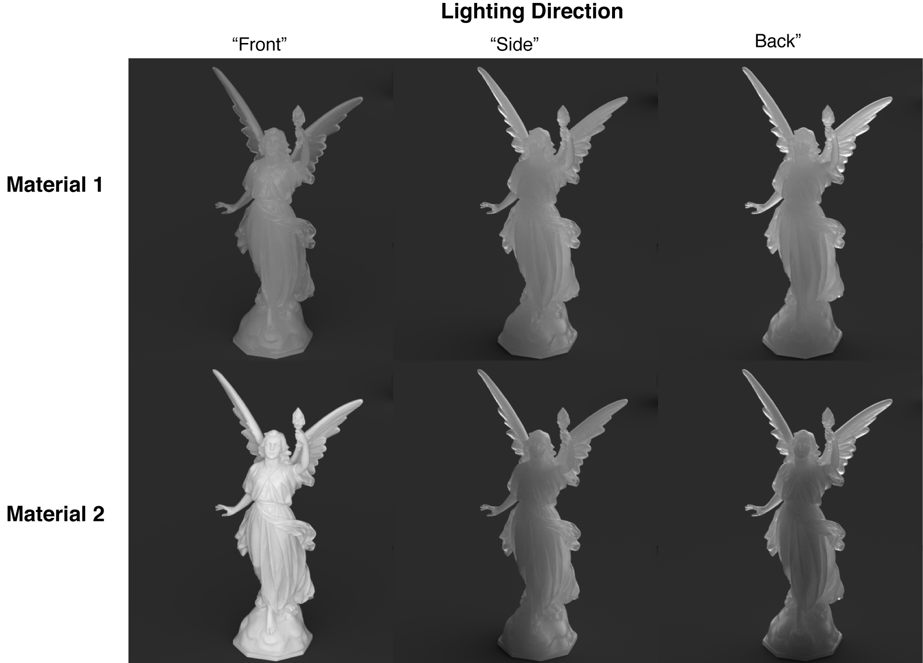
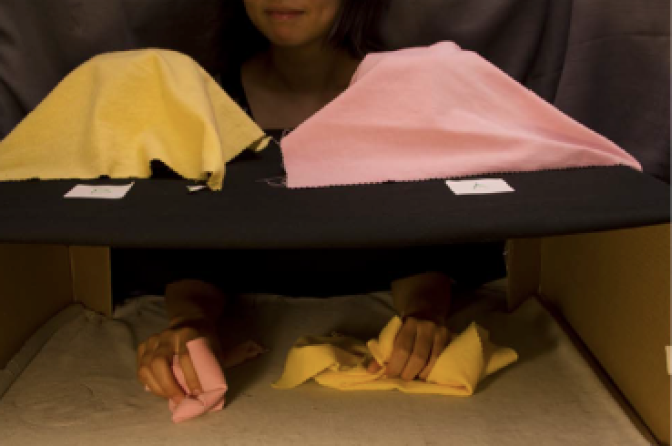
My research: vision and graphics
Physical-realistic rendering of cloth
Inference of material properties
Visual and tactile material categorization
Understanding translucency

Slide 10
Why vision is important?
Visual cortex occupies about 50% of Macaque brain.
More human brain devoted to vision than anything else.
Visual information is essential in robotic system.
Large percentage of effort in neurobiology is dedicated to the visual system.

Slide 11
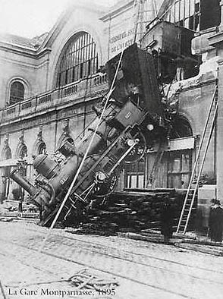
Every image tells a story
Goal of computer vision: perceive the “story” behind the picture
Compute properties of the world
3D shape
Names of people or objects
What happened?

Slide 12
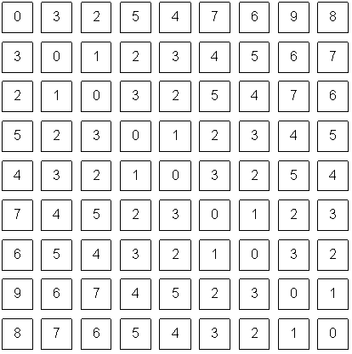
The goal of computer vision

Slide 13
Can the computer match human perception?
Yes and no (mainly no)
computers can be better at “easy” things
humans are much better at “hard” things
But huge progress has been made
Accelerating in the last 4 years due to deep learning
What is considered “hard” keeps changing

Slide 14
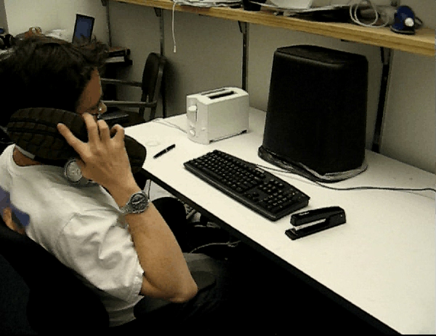


Slide 15
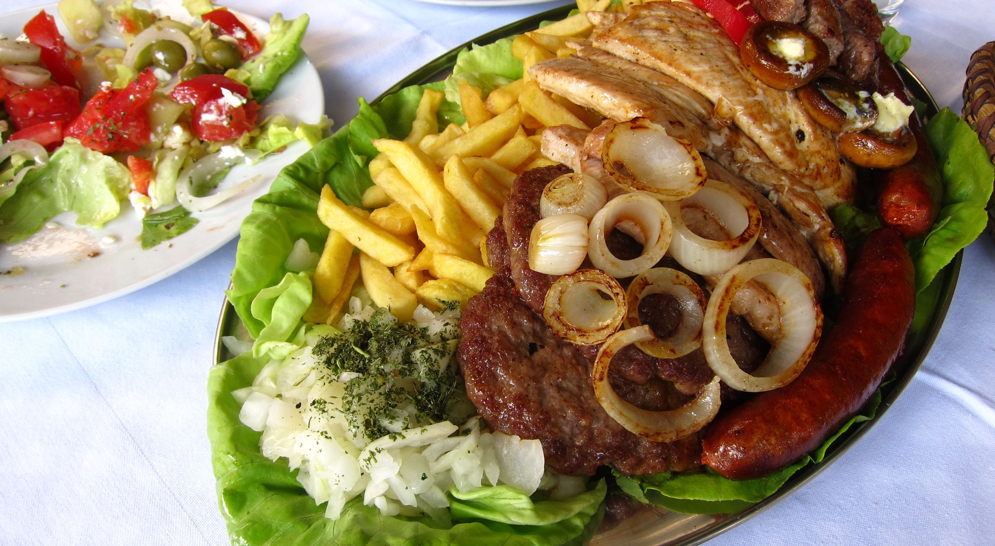
What is computer vision?
What kind of food is it?
What kind of meat?
Are there any vegetables in the image?
What kind of cuisine is it?
What are the most useful utensils to use to eat the food? Knife and fork?

Slide 16
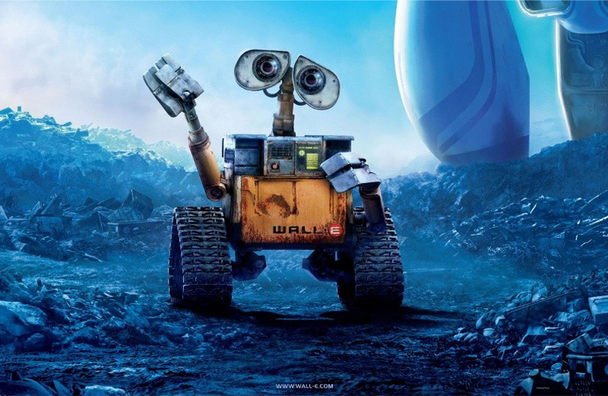
The goal of computer vision

Slide 17
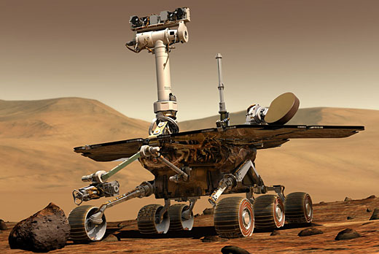
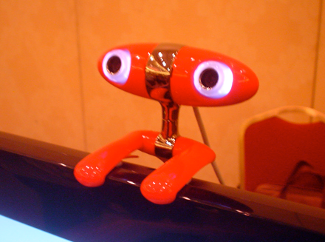
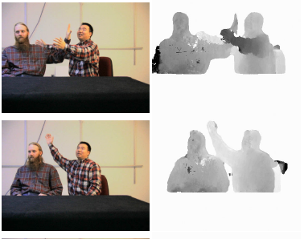
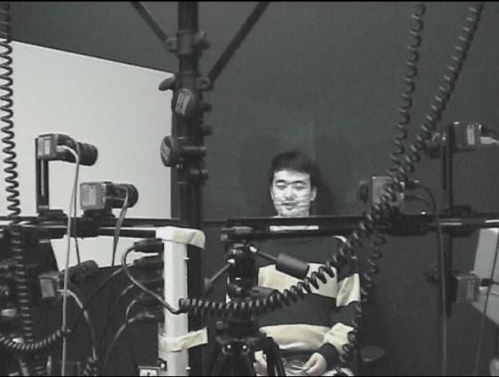
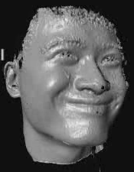
The goal of computer vision
Compute the 3D shape of the world

Slide 18
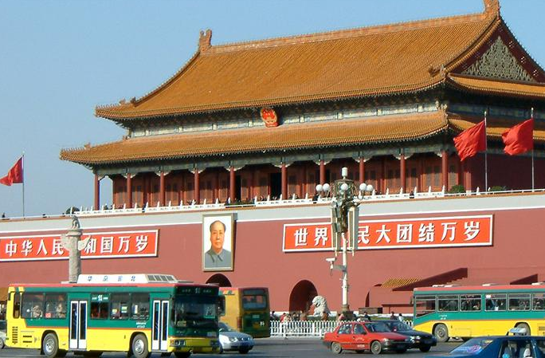
Slide courtesy from Noah Snavely
slide credit: Fei-Fei, Fergus & Torralba

Slide 19
sky
building
flag
face
banner
wall
street lamp
bus
bus
cars
slide credit: Fei-Fei, Fergus & Torralba
Slide courtesy from Noah Snavely

Slide 20
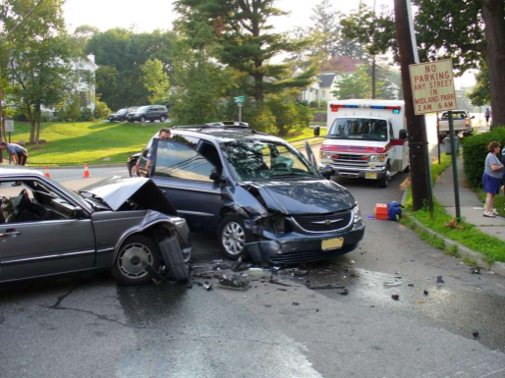
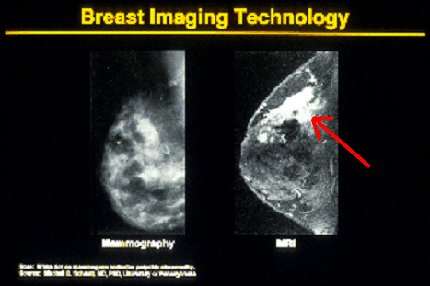
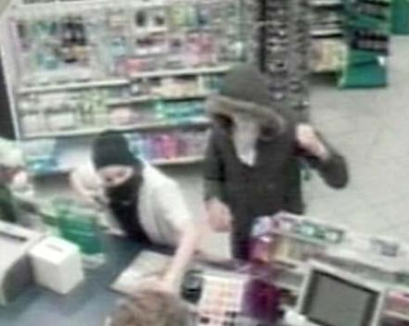
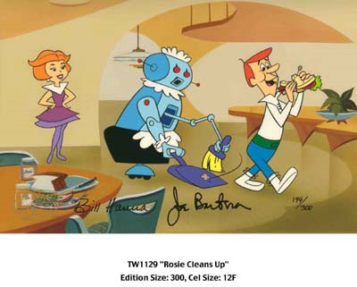
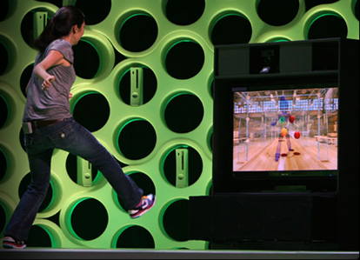
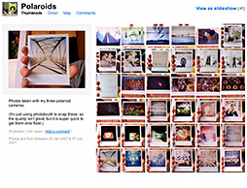
Computer Vision Applications
Safety
Health
Security
Comfort
Fun
Access
Slides from James Hayes

Slide 21
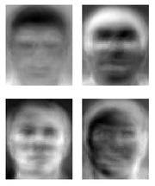
Ridiculously short history of CV
1966: Minsky assigns computer vision as an undergrad summer project
1960’s: interpretation of synthetic worlds
1970’s: some progress on interpreting selected images
1980’s: ANNs come and go; shift toward geometry and increased mathematical rigor
1990’s: face recognition; statistical analysis in vogue
2000’s: broader recognition; large annotated datasets available; video processing starts
2010’s: Deep learning with ConvNets
2030’s: robot uprising?
Guzman ‘68
Ohta Kanade ‘78
Turk and Pentland ‘91
Notes:
ANNs are artificial neural network

Slide 22
Self driving Cars
Oct 9, 2010. "Google Cars Drive Themselves, in Traffic". The New York Times. John Markoff
June 24, 2011. "Nevada state law paves the way for driverless cars". Financial Post. Christine Dobby
Aug 9, 2011, "Human error blamed after Google's driverless car sparks five-vehicle crash". The Star (Toronto)

Slide 23
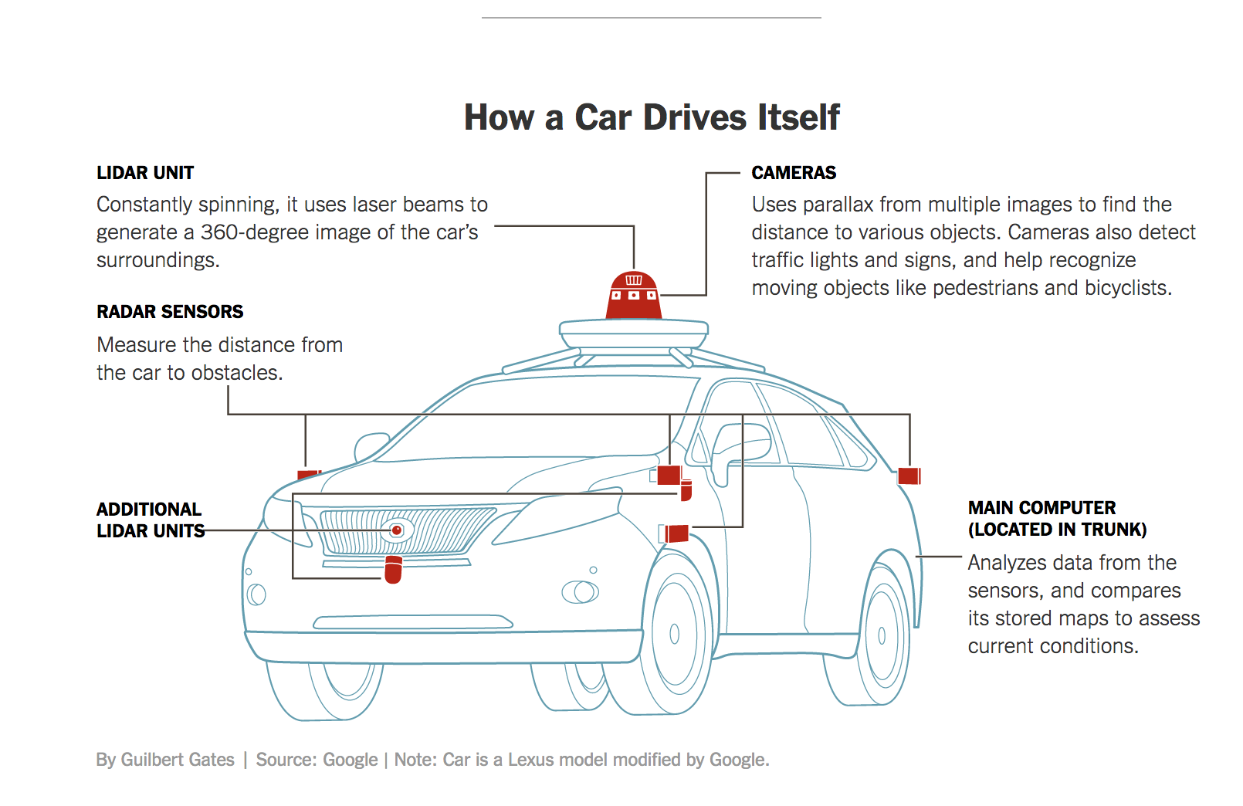
How a car drives itself?
Detect
Moving
Targets
Traffic Lights

Slide 24
How a car drives itself?
For an excellent coverages:
https://www.nytimes.com/interactive/2016/12/14/technology/how-self-driving-cars-work.html
https://www.nytimes.com/2017/05/25/automobiles/wheels/lidar-self-driving-cars.html

Slide 25
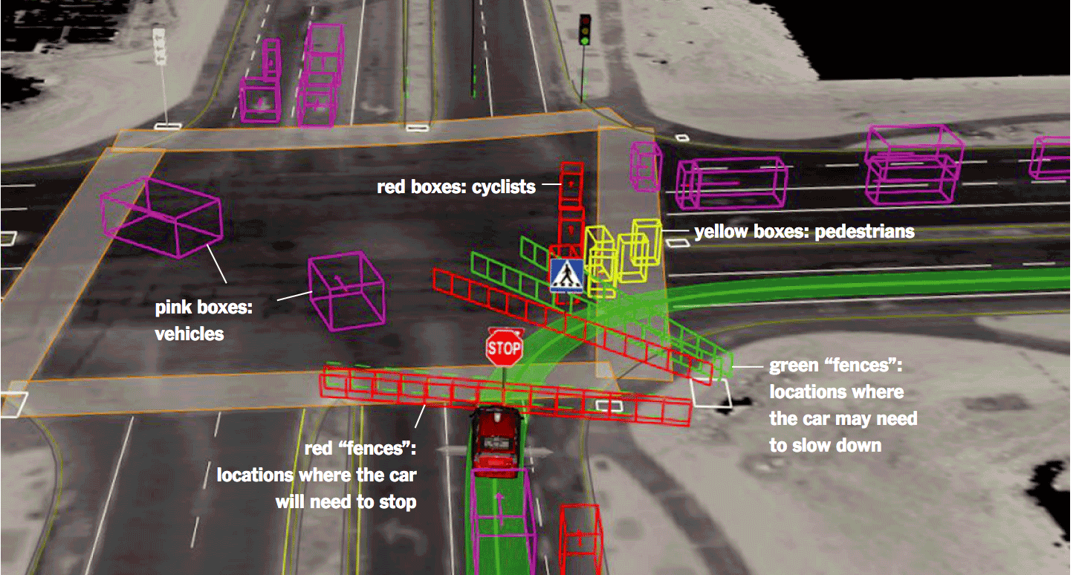
What self-driving cars can see?
https://www.nytimes.com/2017/05/25/automobiles/wheels/lidar-self-driving-cars.html?_r=0

Slide 26
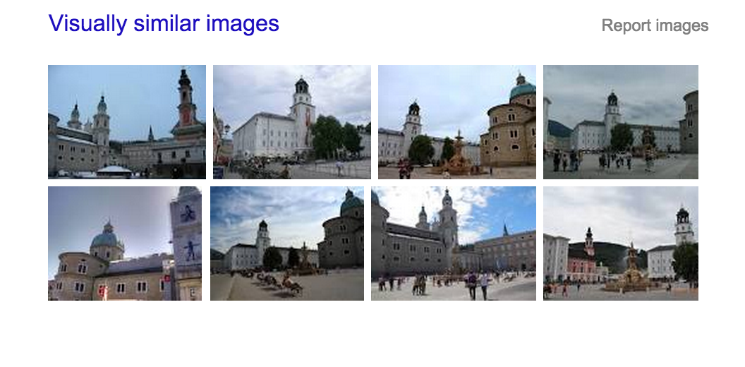
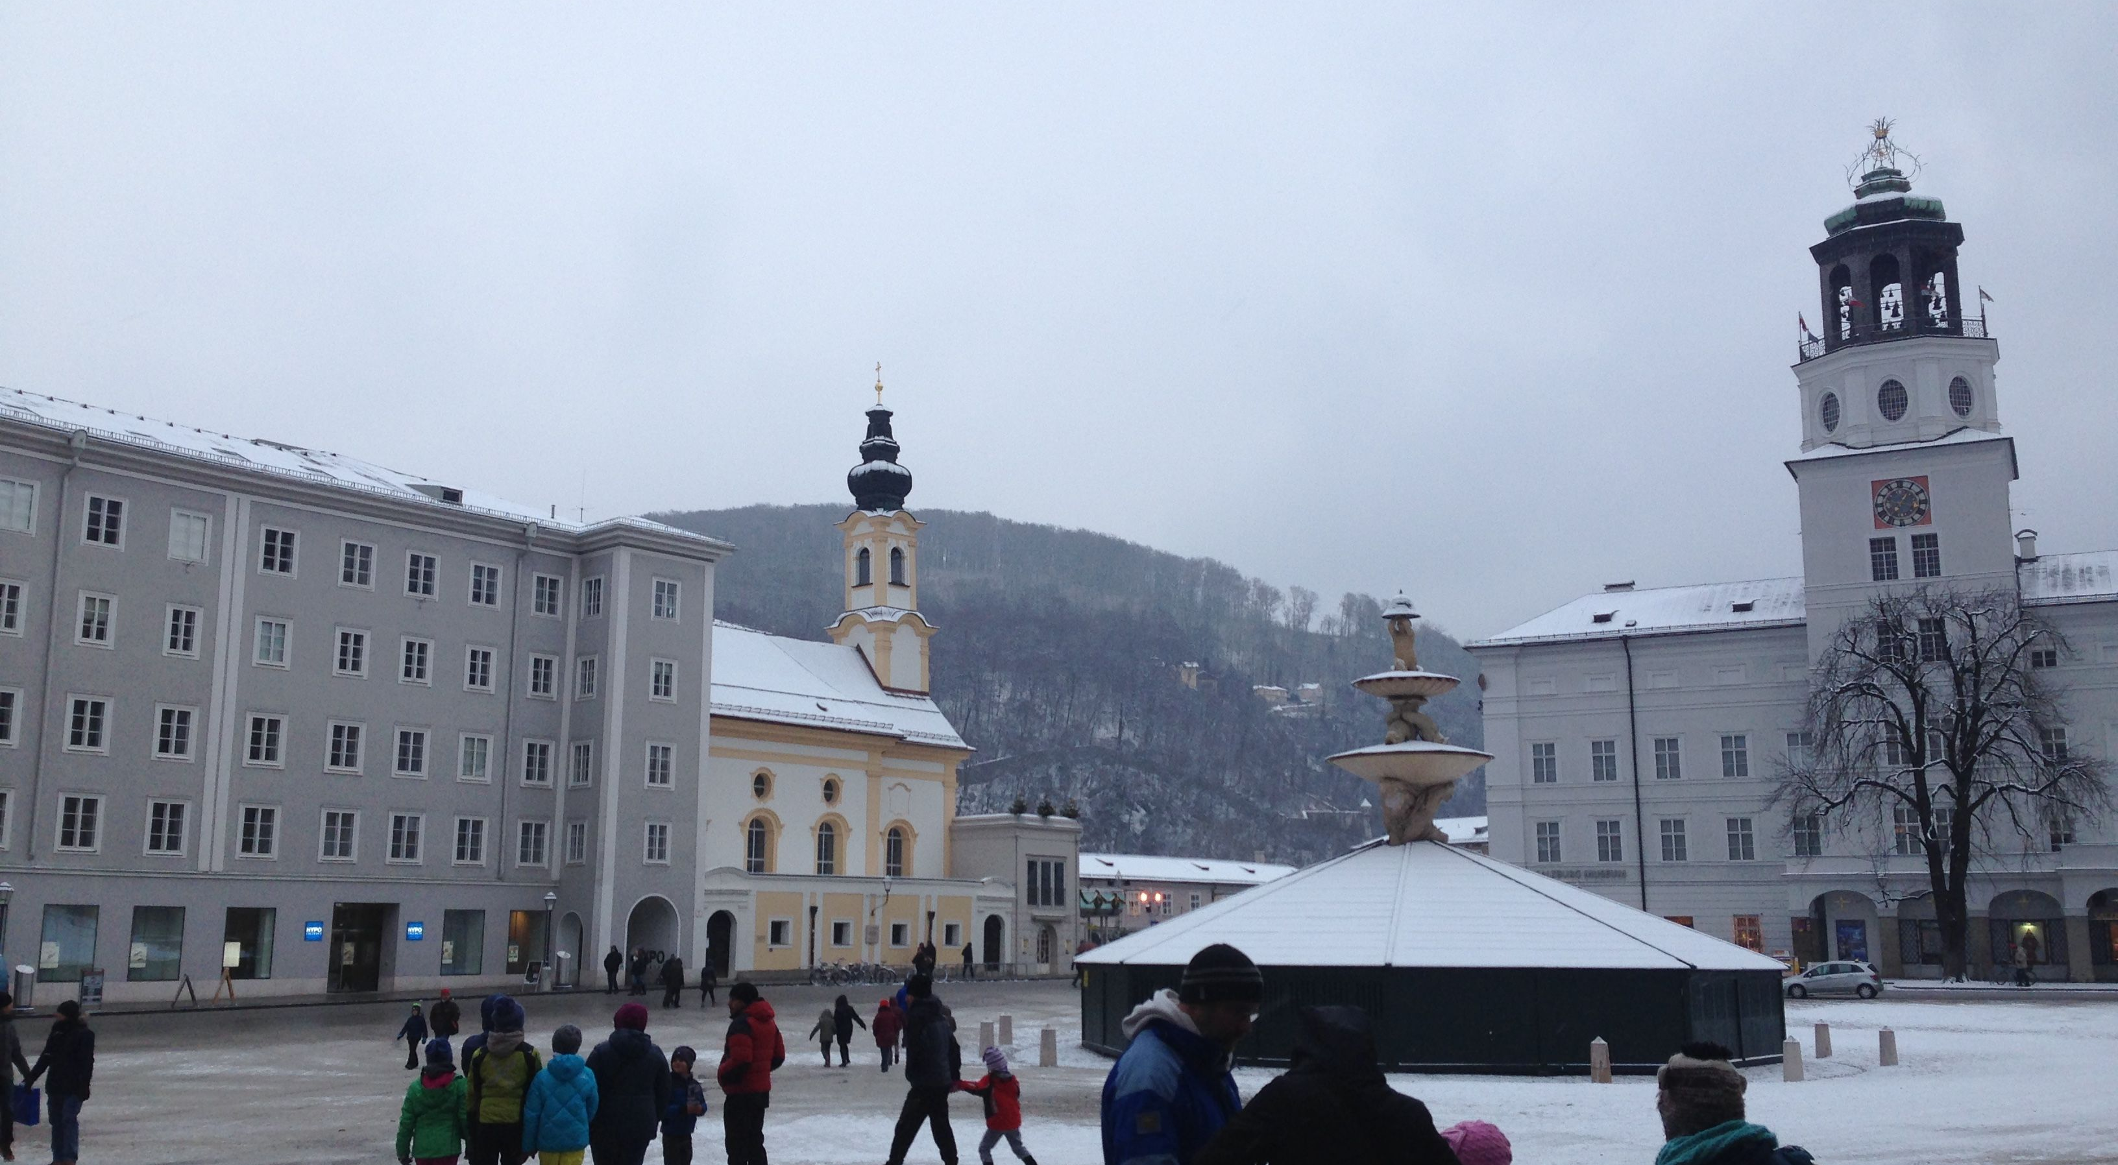
Image-based search
Query image
Label: Residenzplatz, Salzburg, Austria
Usually compares image similarity distance such as similarity in color, texture, shape, etc.
Read about content-based image retrieval

Slide 27
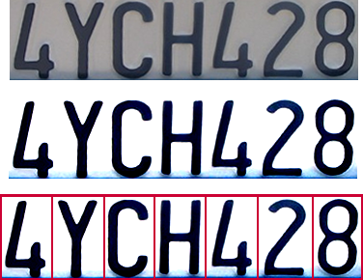

Optical character recognition (OCR)
Technology to convert scanned docs to text
If you have a scanner, it probably came with OCR software
Digit recognition, AT&T labs
http://www.research.att.com/~yann/
License plate readers
http://en.wikipedia.org/wiki/Automatic_number_plate_recognition
Slide from James Hayes

Slide 28
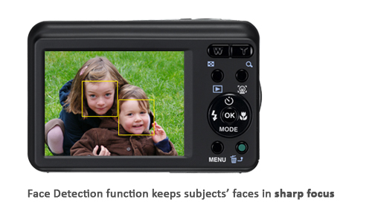
Face Detection

Slide 29
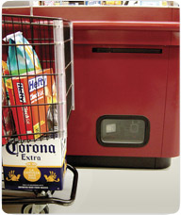
Object recognition (in supermarkets)
LaneHawk by EvolutionRobotics
“A smart camera is flush-mounted in the checkout lane, continuously watching for items. When an item is detected and recognized, the cashier verifies the quantity of items that were found under the basket, and continues to close the transaction. The item can remain under the basket, and with LaneHawk,you are assured to get paid for it… “
Slide from James Hayes

Slide 30
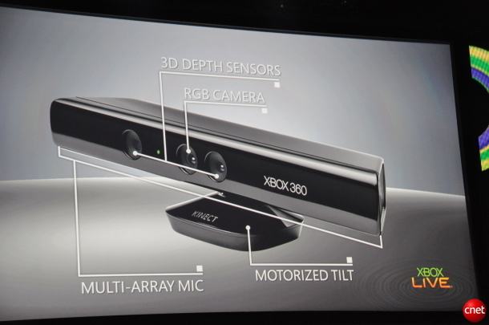
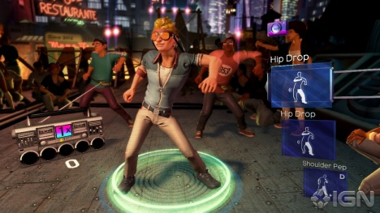
Motion Sensing: Kinect
Robot : https://www.youtube.com/watch?v=w8BmgtMKFbY
Object recognition: https://www.youtube.com/watch?feature=iv&v=fQ59dXOo63o
Slide from James Hayes

Slide 31
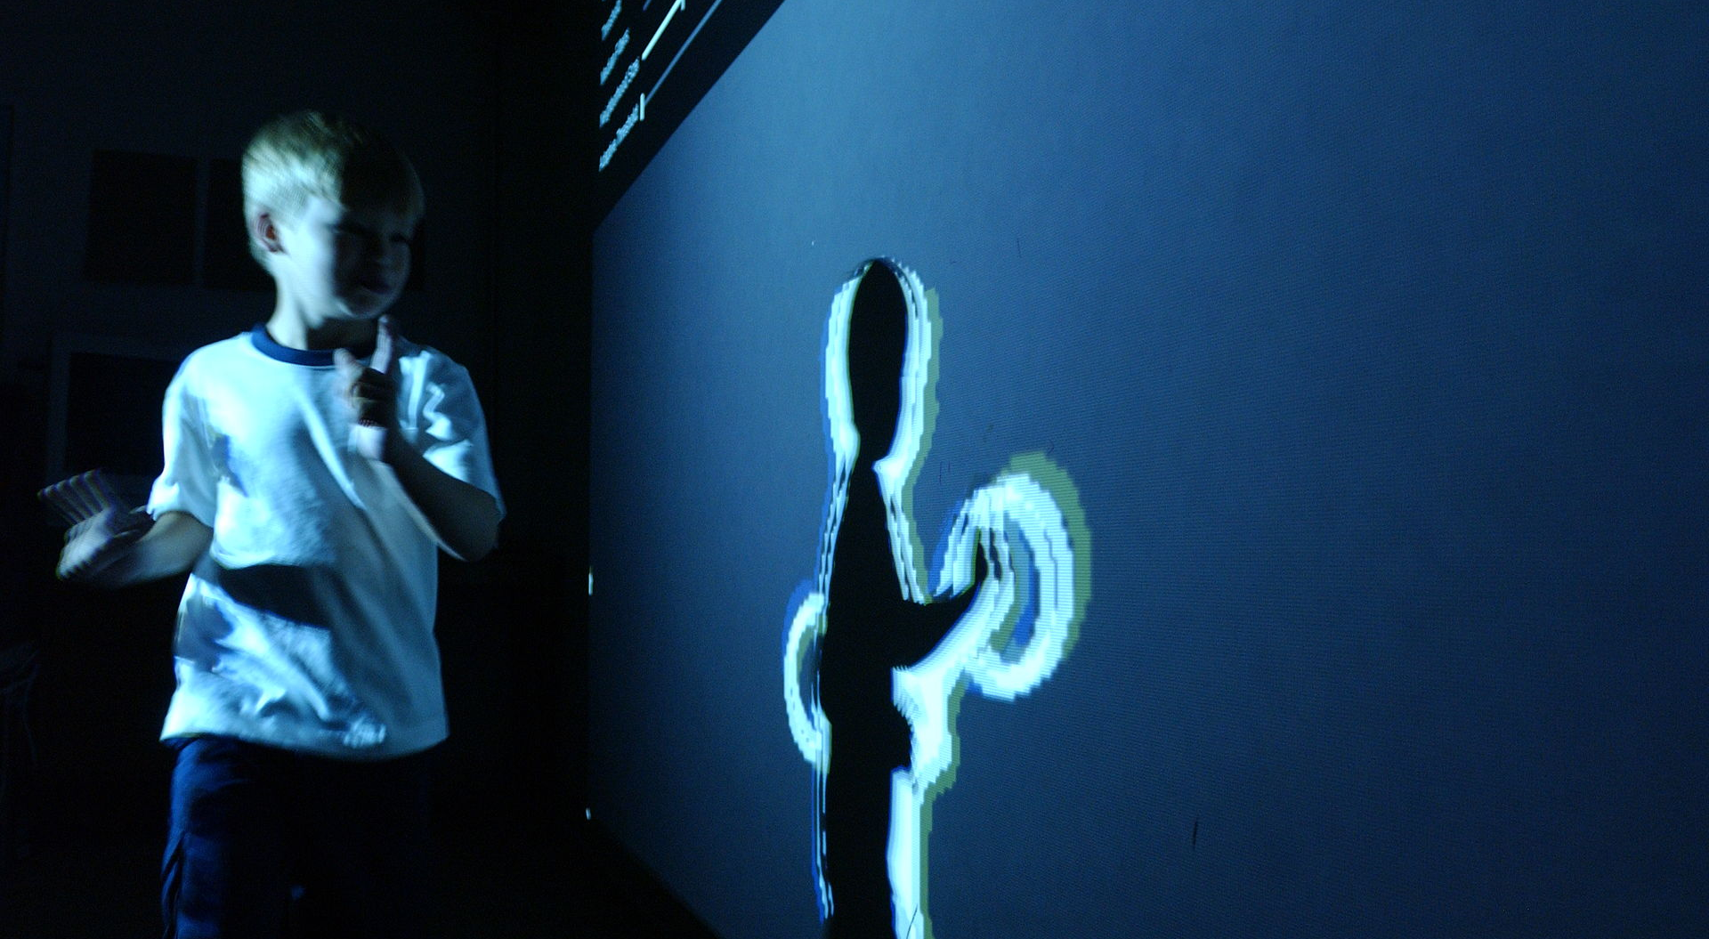
Gesture Recognition
http://www.webopedia.com/TERM/G/gesture_recognition.html
Notes:
Use gestures to control device Human computer interface

Slide 32
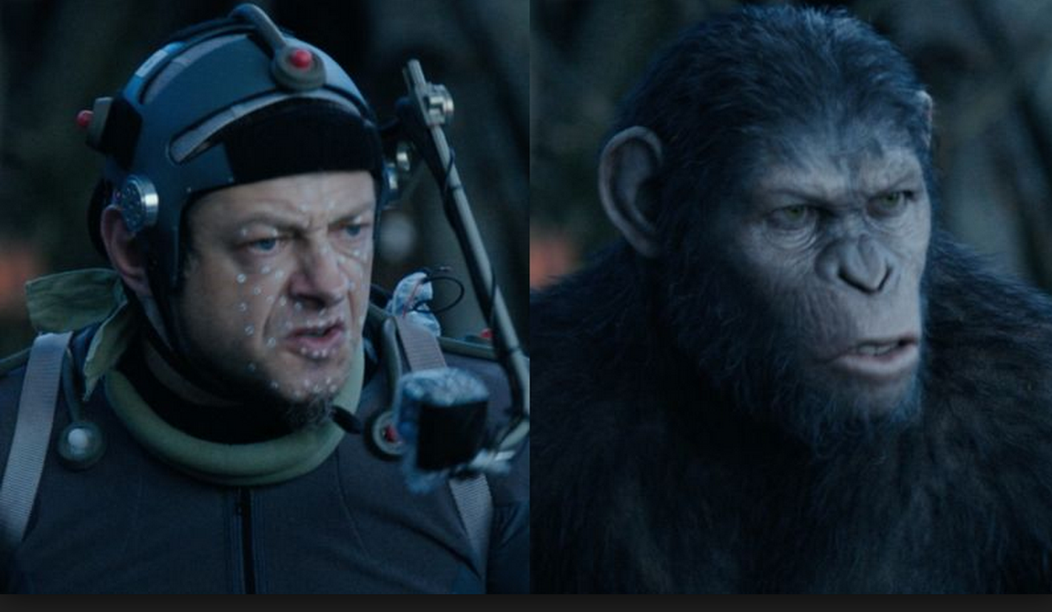
Special effects: motion capture
Dawn Of The Planet of The Apes, Director talks about the visual effects
https://www.youtube.com/watch?v=hlWyAePmAYM
Notes:
using retro-reflective markers viewed from multiple cameras
or other vision-based techniques to capture actors for computer animation;

Slide 33
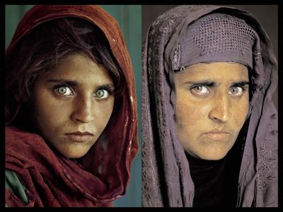
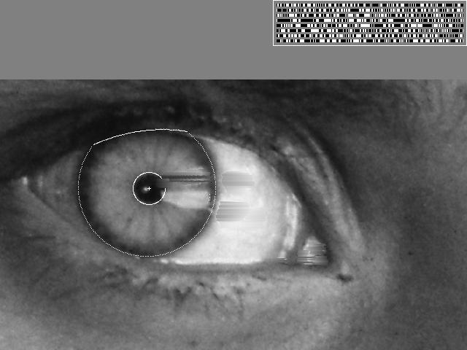

Vision-based biometrics
“How the Afghan Girl was Identified by Her Iris Patterns” Read the story
wikipedia
Slide from James Hayes
Notes:
TimbreGrantCompleteDraftDec.16_BX.docx .docx

Slide 34

The goal of computer vision
Forensics
Source: Nayar and Nishino, “Eyes for Relighting”

Slide 35


Source: Nayar and Nishino, “Eyes for Relighting”

Slide 36

http://www1.cs.columbia.edu/CAVE/projects/eyes_relight/
Source: Nayar and Nishino, “Eyes for Relighting”

Slide 37

http://www1.cs.columbia.edu/CAVE/projects/eyes_relight/

Slide 38

Mobile Eye for driving safety
http://www.mobileye.com/technology/

Slide 39

Leaf Recognition

Slide 40

Bird Identification
Merlin Bird ID (based on Cornell Tech technology!)

Slide 41

Vision in space
NASA'S Mars Exploration Rover Spirit captured this westward view from atop a low plateau where Spirit spent the closing months of 2007.
Vision systems (JPL) used for several tasks
Panorama stitching
3D terrain modeling
Obstacle detection, position tracking
For more, read “Computer Vision On Mars” by Matthies et al.
Slide from James Hayes

Slide 42

Automatic Image and Video Editing
Data driven approach of image editing
Given a single image at day
Database of time-lapse videos
A hallucination of the same scene at night
YiChang Shi, Sylvain Pairs, Fredo Durand, and William T Freeman, SIGGRAPH ASIA 2013

Slide 43


Scene Completion
[Hays and Efros. Scene Completion Using Millions of Photographs. SIGGRAPH 2007 and CACM October 2008.]
Notes:
Introduce gist.

Slide 44


Nearest neighbor scenes from database of 2.3 million photos

Slide 45



Graph cut + Poisson blending

Slide 46

Image Forensics
From Hany Fraid, Digital Image Frensics
http://www.cs.dartmouth.edu/farid/downloads/publications/sciam08.pdf

Slide 47

Image Forensics
Arrows indicates light source direction
They are not shot
Together.
2. The girl’s helmet
is the same as the man’s
but recolored.
From Hany Fraid, Digital Image Frensics
http://www.cs.dartmouth.edu/farid/downloads/publications/sciam08.pdf

Slide 48

Applications of Computer Vision: Detecting cloning
From Hany Fraid, Digital Image Forensics
http://www.cs.dartmouth.edu/farid/downloads/publications/sciam08.pdf

Slide 49

Notes:
You may have read this headline last year and thought: 2 billion! That’s crazy? What is Virtual Reality? And why is it going to be so big?

Slide 50




Virtual & Augmented Reality
6DoF head tracking
Hand & body tracking
3D scene understanding
3D-360 video capture

Slide 51

Smart phone and augmented reality

Slide 52
Can the computer match human perception?
What does human vision have:
Amazing eyes (sensor) and big brain
Experiences in the real-world (Prior knowledge)
Good at solving hard problems with ambiguous information
What does computer vision have?
Lots of CPUs, fast speed
Mathematical techniques
Data, data, data ((could we learn from constraints from data)
Fast at solving simple and tedious problems
But tremendous progress has been made of solving hard problem such as human activity understanding
Slide courtesy from Noah Snavely

Slide 53
Why vision is hard?
We must estimate 3D properties ( texture, color, surface properties) of a visual scene from 2D images?
It is an inverse problem under-constrained.
Slide courtesy from Noah Snavely

Slide 54

Vision is an inverse problem
Construct 3D from 2D images
Notes:
Size constancy expansion: objects appear wider when seen further away

Slide 55

Vision is an inverse problem
Notes:
A. A line drawing provides information only about x, y coordinates of points lying along the object contours.
B. The human visual system is usually able to reconstruct an object in three dimensions given only a single 2D projection.
C. Any planar line-drawing is geometrically consistent with infinitely many 3D structures.

Slide 56

Vision is hard
Slide courtesy from Antonio Torralba
Notes:
Size constancy expansion: objects appear wider when seen further away

Slide 57







Why is computer vision difficult?
Viewpoint variation
Scale
Illumination
Slide courtesy from Noah Snavely

Slide 58






Why is computer vision difficult?
Motion (Source: S. Lazebnik)
Intra-class variation
Background clutter
Occlusion

Slide 59

Vision is hard
Muller-Lyer illusion

Slide 60

Vision is hard
What is the most likely scenario?
Prior knowledge: Occlusion is more common than L shaped object
Notes:
Figure 1.2 shows different images that illustrate that the human visual system is trying to recover the scenes that are the cause of those images. In the first image, we see a red square occluding a smaller blue square. This is the most natural interpretation of the scene if we assume that squares are typical in the world and that occlusions are common. Even though the green figure shows us that L-shaped figures are possible, we interpret the blue L-shaped figure as an occluded square. The next image shows the ”turning tables” illusion by Roger Shepard. In this illusion, both table tops have the same shape and size but one is rotated with respect to the other. The visual system insists in interpreting this objects as 3D objects giving the impression that the left table is longer than the table of the right. And this perception can not be shut down even if we know exactly how this image has been generated. The third example shows the Checkershadow illusion by E. Adelson. In this figure, the squares marked with A and B have the exact same intensity values. But the visual system may be trying to measure the real intensity of the squares that are part of a 3D scene with a shadow. The visual system tries to remove the effect of the shadow to infer the true gray value of each square. As a result, the square in the shadow is perceived as being lighter than the square outside the shadow region, despite that both have the exact same gray levels

Slide 61

Vision is hard
Edward Adelson

Slide 62

Vision is hard
Roger Shepard
http://www.opticalillusion.net/optical-illusions/shepards-tables-whats-up/
Notes:
Size constancy expansion: objects appear wider when seen further away

Slide 63

Bottom line
Perception is an inherently ambiguous problem
Many different 3D scenes could have given rise to a particular 2D picture
We often need to use prior knowledge about the structure of the world
Image source: F. Durand

Slide 64


Slide 67
But what do we have?
Lots and lots and lots of data.
We can learn from humans.
We have Prior knowledge, which can provide constrains of the problem.

Slide 68
Computer Vision and Nearby Fields
Computer Graphics: Models to Images
Computational Photography: Images to Images
Computer Vision: Images to Models
Human perception: understand how humans perceive the world
Machine learning (tools that are common in all above areas): algorithm of how to learn from data

Slide 69

Computer Vision and Nearby Fields

Slide 70
My research: automatic material recognition from images and videos

Slide 71




What we are going to learn?
Low-level vision
image processing, edge detection, feature detection, cameras, image formation
Geometry and algorithms
projective geometry, stereo, structure from motion, Markov random fields
Recognition
face detection / recognition, category recognition, segmentation
Light, color, and reflectance

Slide 72
General description
The course is extremely hands-on and requires working knowledge of Python. CSC 280 is recommended. If you haven’t taken CSC 280, please talk to me after class.
Class time is often used for group discussions and quiz. Attendance is STRONGLY recommended. Absence for 3 times without medical/ family illness proof will receive 0% attendance score.
Textbooks are ONLY supplementary to lectures. Content can change depending on progress. Assigned reading could be papers.

Slide 73

Textbook
Textbook
http://szeliski.org/Book/

Slide 74

Textbook
Textbook
http://programmingcomputervision.com/

Slide 75
Grading
60 % Homework assignments. 5 projects + 1 homework.
10 % Mid-term exam (written)
15% Final project
5 % Attendance
10% In-class quiz

Slide 76



Project: Hybrid images from image pyramids

Slide 77
Syllabus
Homework late policy:
4 free late days for homework only (not final project)– use them in your ways;
No late submission is accepted after 4 late days are used.

Slide 78
Prerequisites
CSC 280 and 281 (preferred)
Linear algebra, basic calculus, and probability recommended.
No previous experience with image processing is required.

Slide 79
Course requirements
Prerequisites—these are essential!
Data structures
A good working knowledge of Python programming
Linear algebra
Vector calculus
Course does not assume prior imaging experience
computer vision, image processing, graphics, etc.

Slide 80
Academic Integrity
You must not copy lines of code from other people unless teamwork is allowed. Final project, for example, allows teamwork. But individual homework assignment does not. You can discuss your homework with other people but you must declare with whom you discussed with.
You must not copy lines of code from internet including online forums.

Slide 81
Office hours
Wed: 3:30-4:30pm
Friday: 2:30-3:30pm
Location: Myers Technology building *this building, Room 204.
Connect to course GITHUB site

Slide 82
Take-home Reading
Szelisky : Chapter 1, What is computer vision?
Finish the warm up exercises.

